Slide 1


GARBAGE-GUARD
Development of Computer Vision for Creeks Garbage Detection Using Convolutional Neural Network
Brian Jay Celeste
Genesis Walter D. Reyes II
Jade C. Gunayan
King Perth G. Pepito
Rodel S. Banogbanog
Thesis Adviser: Dr. Jonel R. Macalisang

Slide 2














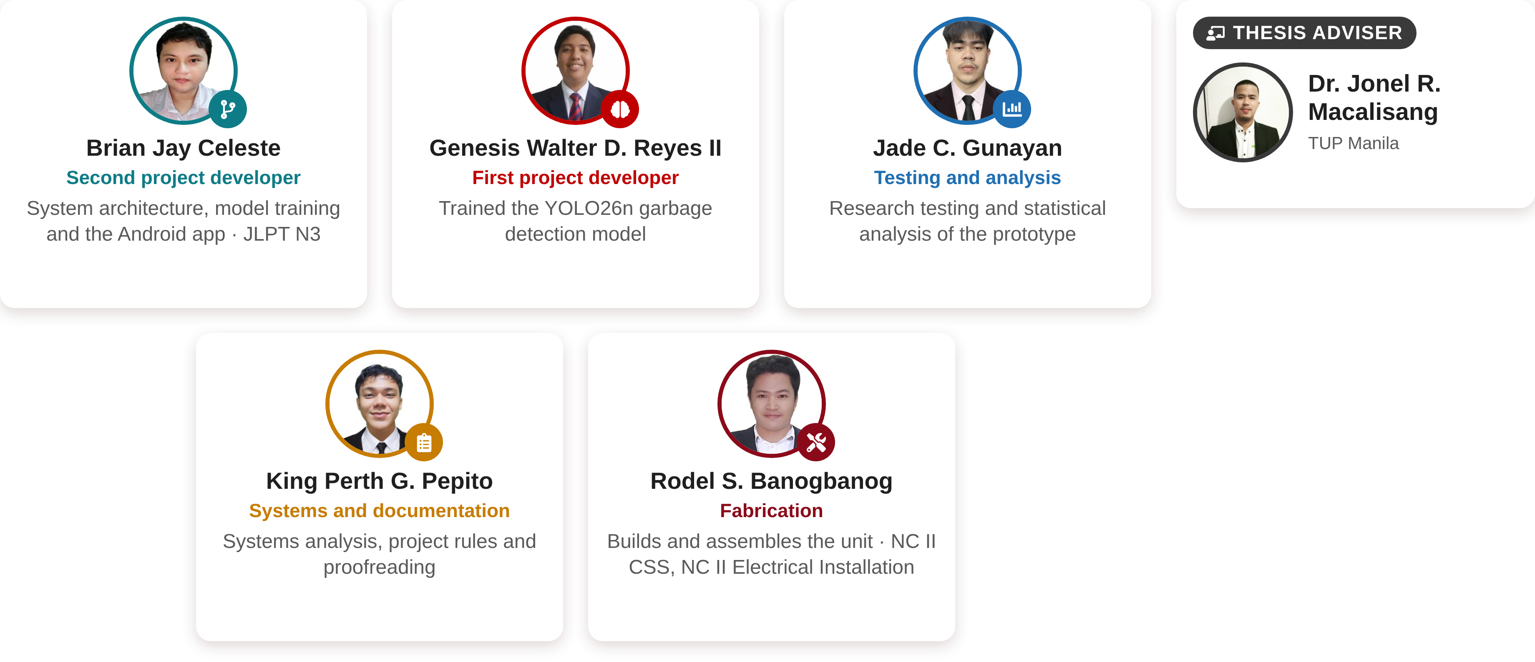
The Researchers
CURRICULUM VITAE
THESIS ADVISER
Dr. Jonel R. Macalisang
Brian Jay Celeste
Genesis Walter D. Reyes II
Jade C. Gunayan
TUP Manila
Second project developer
First project developer
Testing and analysis
System architecture, model training and the Android app · JLPT N3
Trained the YOLO26n garbage detection model
Research testing and statistical analysis of the prototype
King Perth G. Pepito
Rodel S. Banogbanog
Systems and documentation
Fabrication
Systems analysis, project rules and proofreading
Builds and assembles the unit · NC II CSS, NC II Electrical Installation

Slide 3
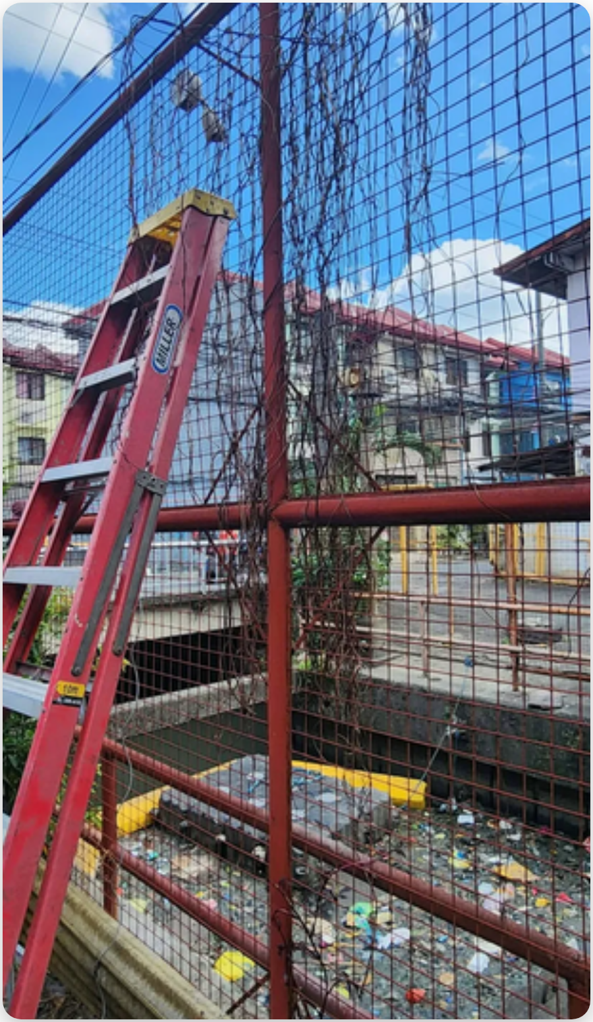


















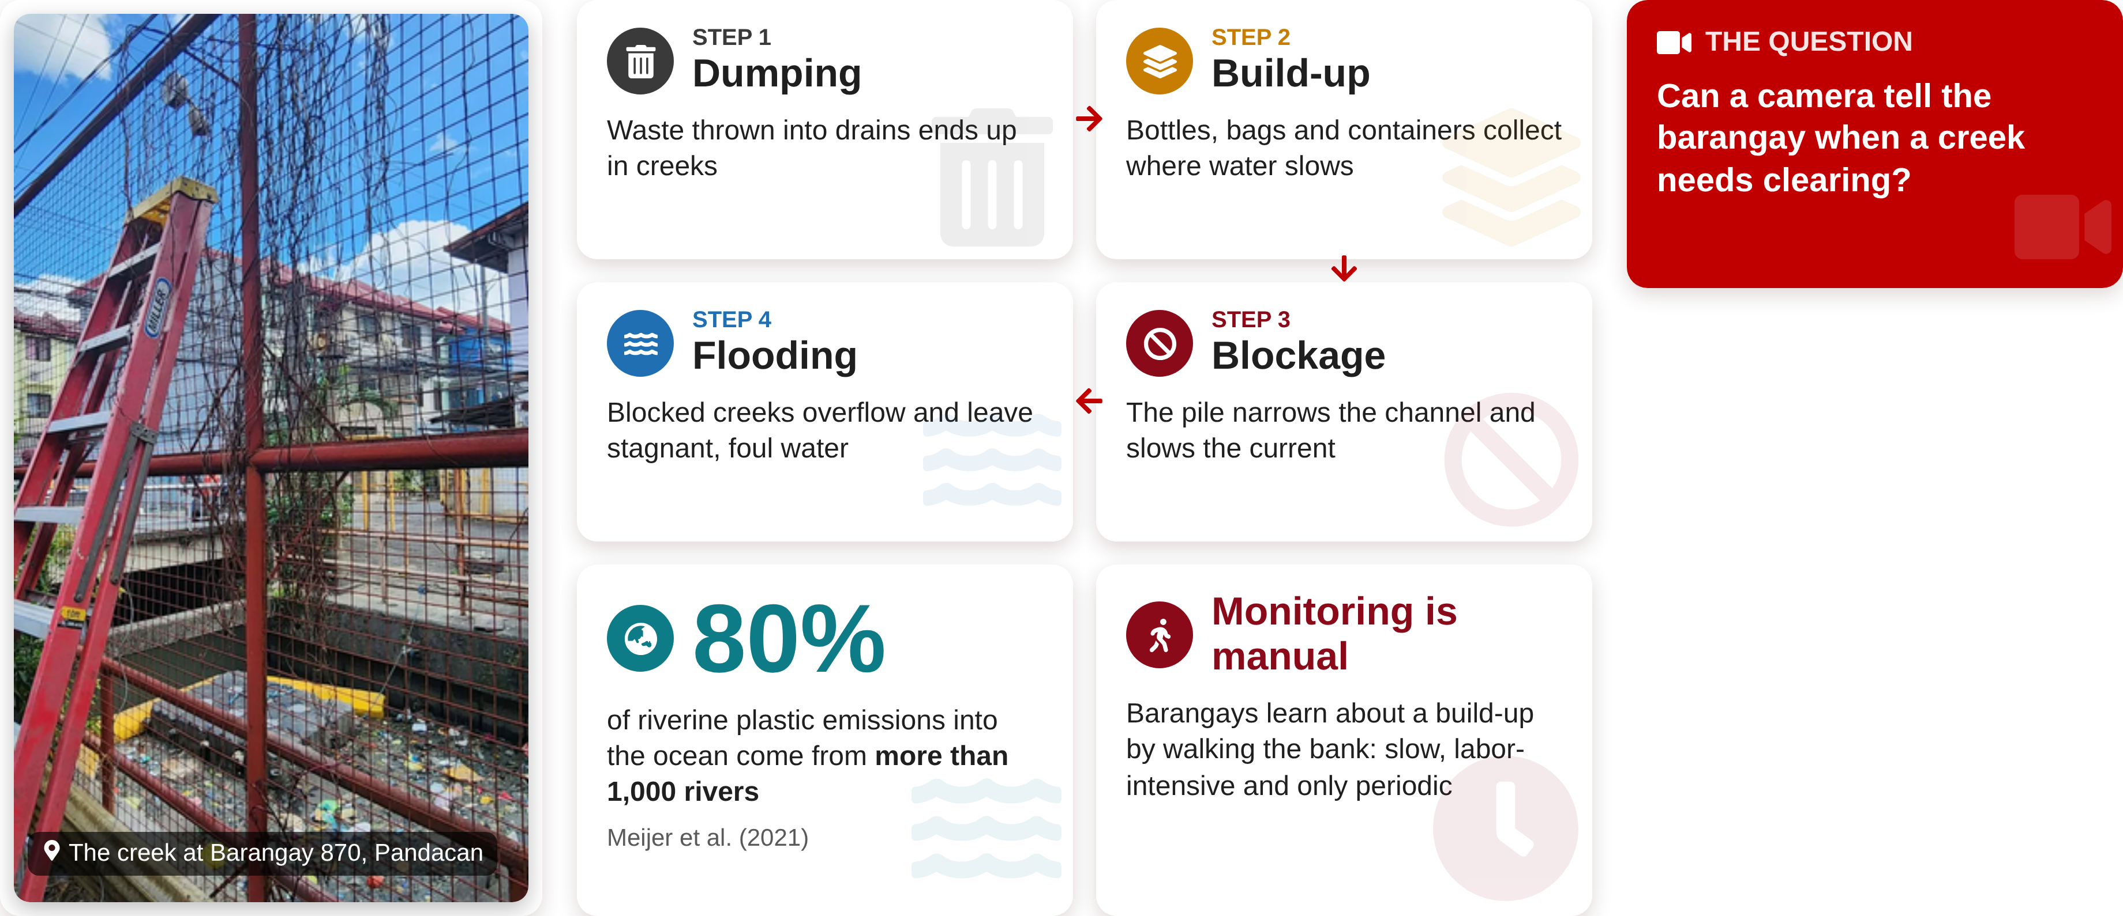
Garbage in Urban Creeks
BACKGROUND OF THE STUDY
STEP 1
STEP 2
THE QUESTION
Dumping
Build-up
Can a camera tell the barangay when a creek needs clearing?
Waste thrown into drains ends up in creeks
Bottles, bags and containers collect where water slows
STEP 4
STEP 3
Flooding
Blockage
Blocked creeks overflow and leave stagnant, foul water
The pile narrows the channel and slows the current
80%
Monitoring is manual
of riverine plastic emissions into the ocean come from more than 1,000 rivers
Barangays learn about a build-up by walking the bank: slow, labor-intensive and only periodic
The creek at Barangay 870, Pandacan
Meijer et al. (2021)

Slide 4















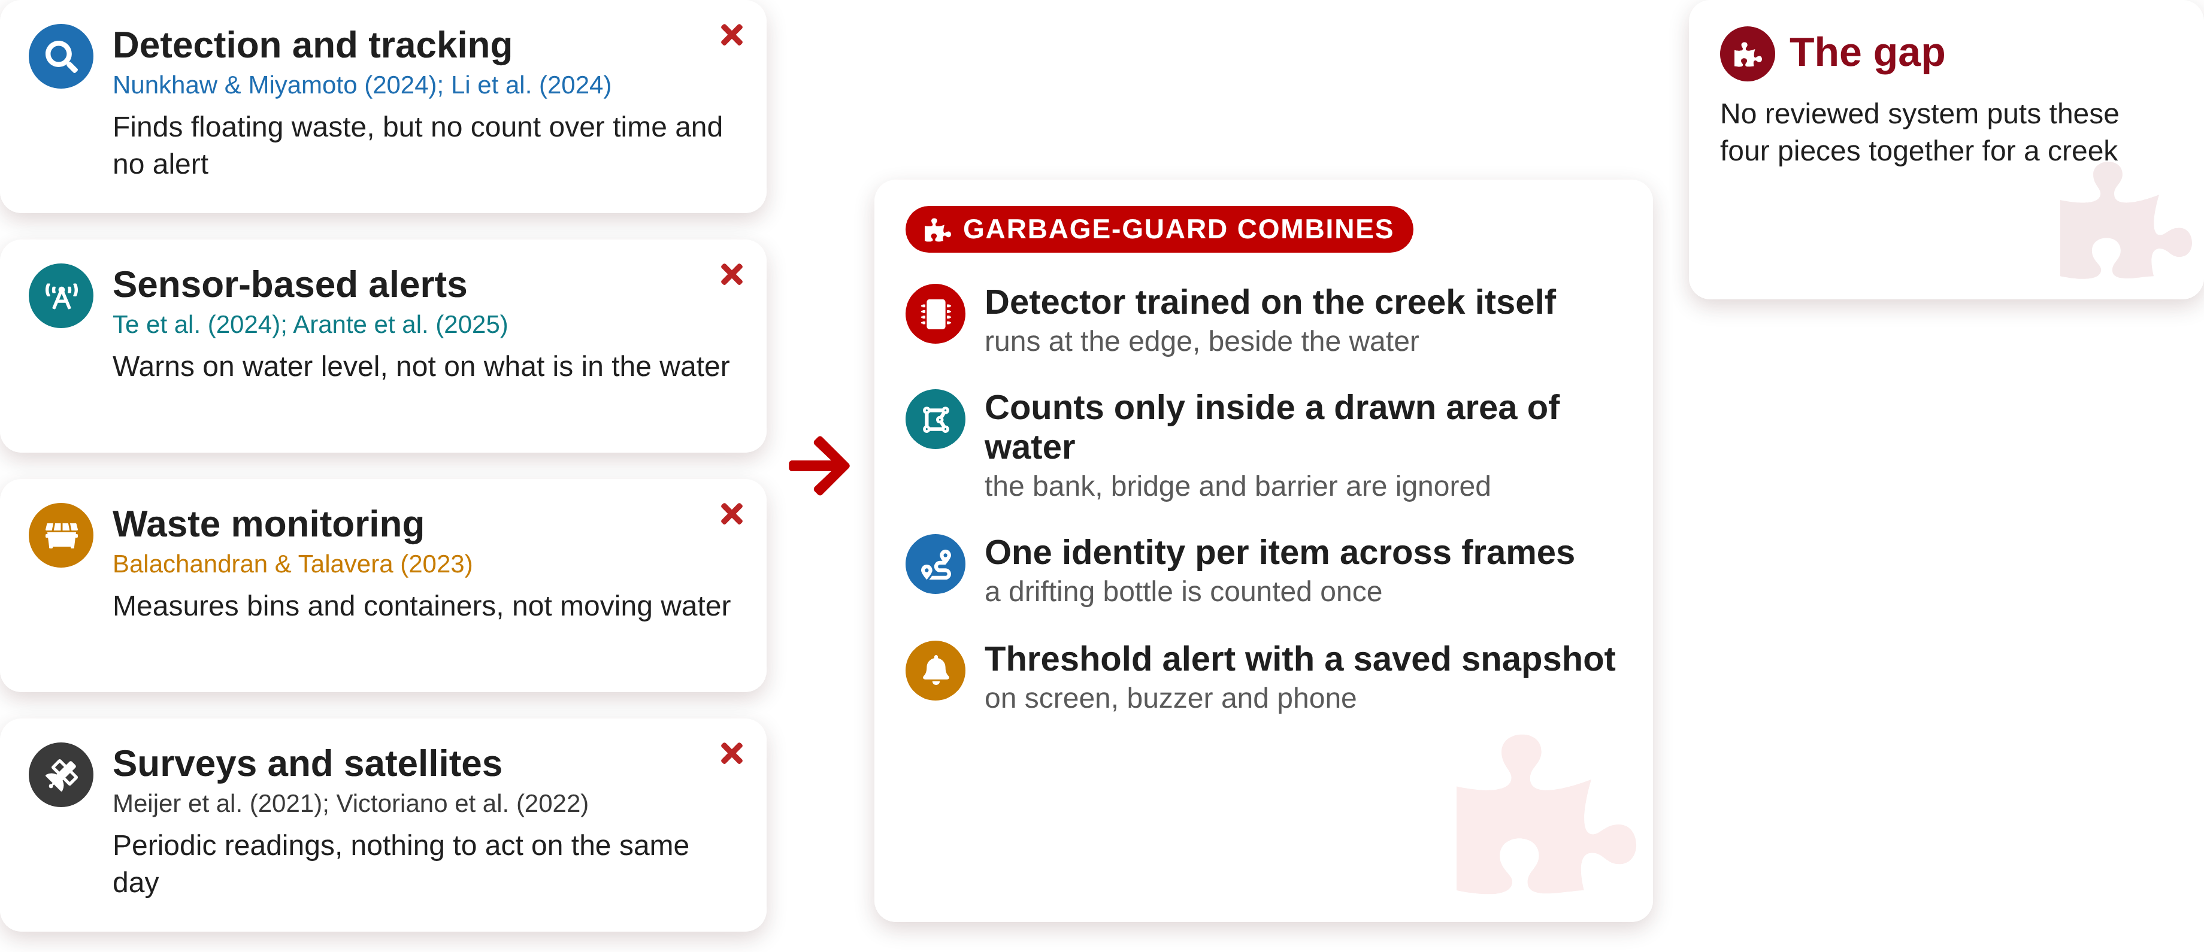
The Research Gap
BACKGROUND OF THE STUDY
Detection and tracking
The gap
Nunkhaw & Miyamoto (2024); Li et al. (2024)
No reviewed system puts these four pieces together for a creek
Finds floating waste, but no count over time and no alert
GARBAGE-GUARD COMBINES
Sensor-based alerts
Detector trained on the creek itself
Te et al. (2024); Arante et al. (2025)
runs at the edge, beside the water
Warns on water level, not on what is in the water
Counts only inside a drawn area of water
the bank, bridge and barrier are ignored
Waste monitoring
Balachandran & Talavera (2023)
One identity per item across frames
Measures bins and containers, not moving water
a drifting bottle is counted once
Threshold alert with a saved snapshot
on screen, buzzer and phone
Surveys and satellites
Meijer et al. (2021); Victoriano et al. (2022)
Periodic readings, nothing to act on the same day

Slide 5







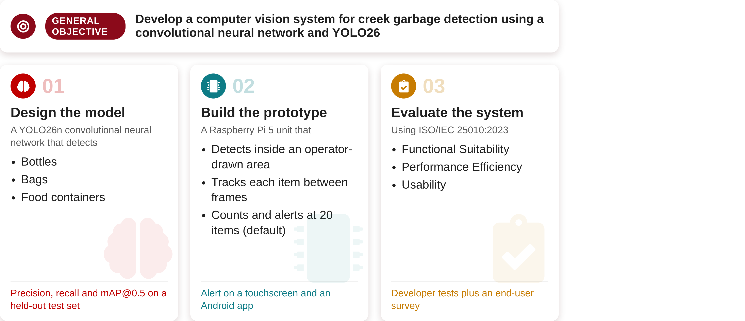
Objectives
OBJECTIVES OF THE STUDY
GENERAL OBJECTIVE
Develop a computer vision system for creek garbage detection using a convolutional neural network and YOLO26
01
02
03
Design the model
Build the prototype
Evaluate the system
A YOLO26n convolutional neural network that detects
A Raspberry Pi 5 unit that
Using ISO/IEC 25010:2023
Detects inside an operator-drawn area
Functional Suitability
Bottles
Performance Efficiency
Bags
Tracks each item between frames
Usability
Food containers
Counts and alerts at 20 items (default)
Precision, recall and mAP@0.5 on a held-out test set
Alert on a touchscreen and an Android app
Developer tests plus an end-user survey

Slide 6













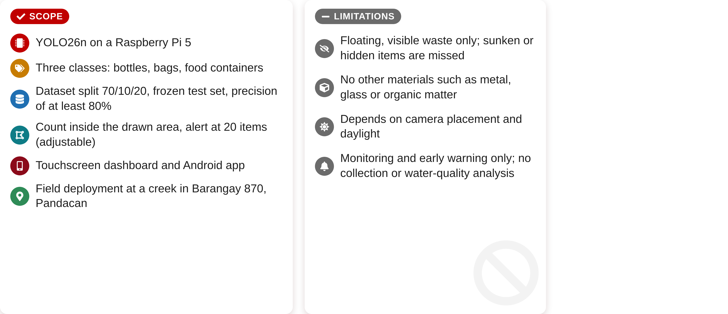
Scope and Limitations
SCOPE AND LIMITATIONS OF THE STUDY
SCOPE
LIMITATIONS
YOLO26n on a Raspberry Pi 5
Floating, visible waste only; sunken or hidden items are missed
Three classes: bottles, bags, food containers
No other materials such as metal, glass or organic matter
Dataset split 70/10/20, frozen test set, precision of at least 80%
Count inside the drawn area, alert at 20 items (adjustable)
Depends on camera placement and daylight
Touchscreen dashboard and Android app
Monitoring and early warning only; no collection or water-quality analysis
Field deployment at a creek in Barangay 870, Pandacan

Slide 7
















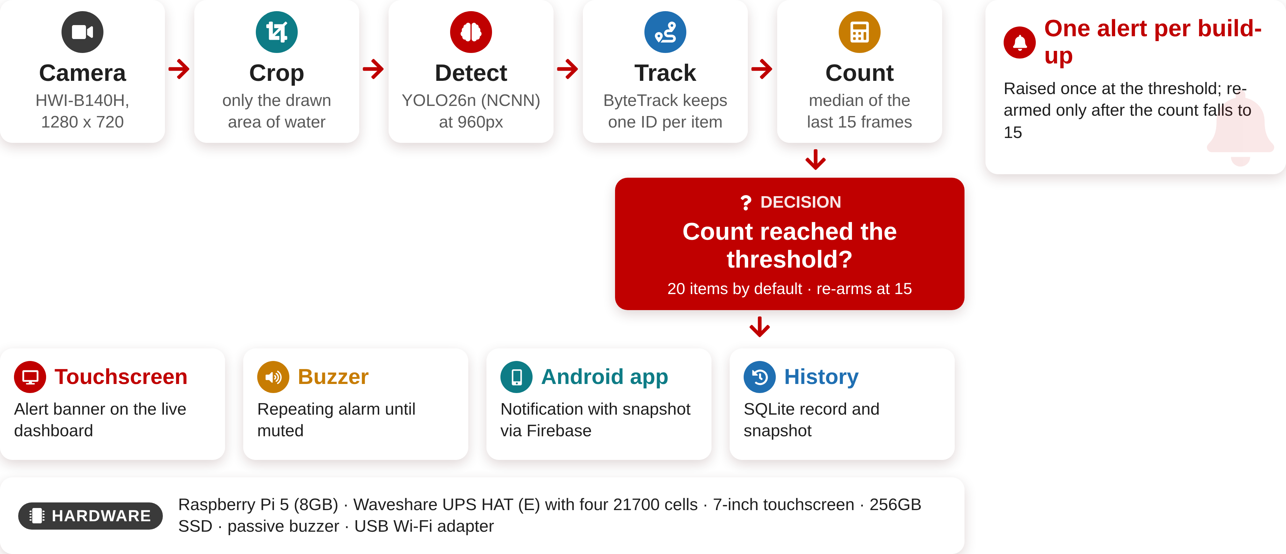
How Garbage-Guard Works
DESIGN
One alert per build-up
Camera
Crop
Detect
Track
Count
HWI-B140H,
1280 x 720
only the drawn
area of water
YOLO26n (NCNN)
at 960px
ByteTrack keeps
one ID per item
median of the
last 15 frames
Raised once at the threshold; re-armed only after the count falls to 15
DECISION
Count reached the threshold?
20 items by default · re-arms at 15
Touchscreen
Buzzer
Android app
History
Alert banner on the live dashboard
Repeating alarm until muted
Notification with snapshot via Firebase
SQLite record and snapshot
HARDWARE
Raspberry Pi 5 (8GB) · Waveshare UPS HAT (E) with four 21700 cells · 7-inch touchscreen · 256GB SSD · passive buzzer · USB Wi-Fi adapter

Slide 8
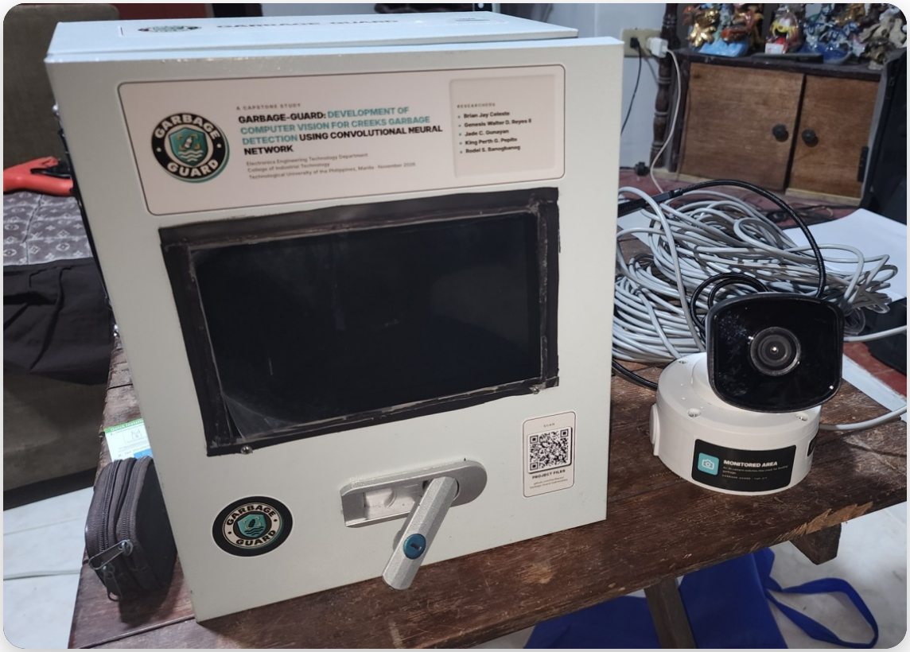
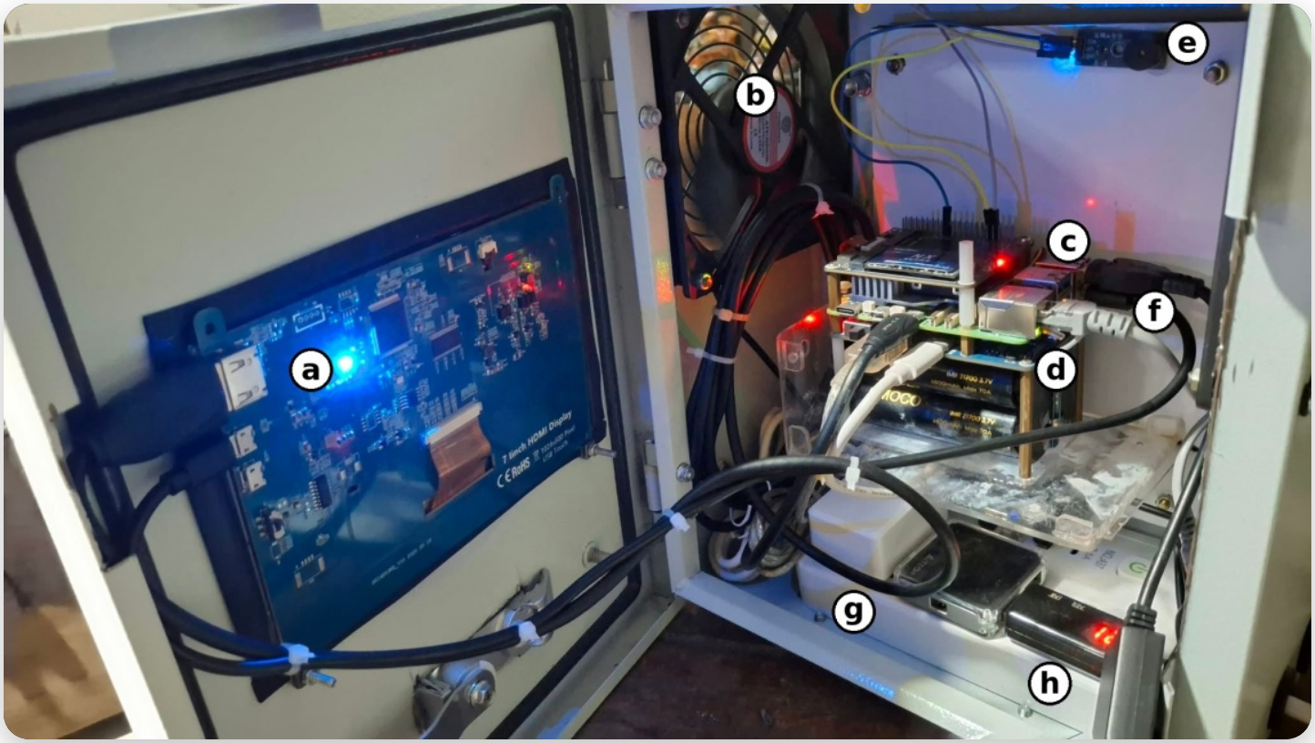


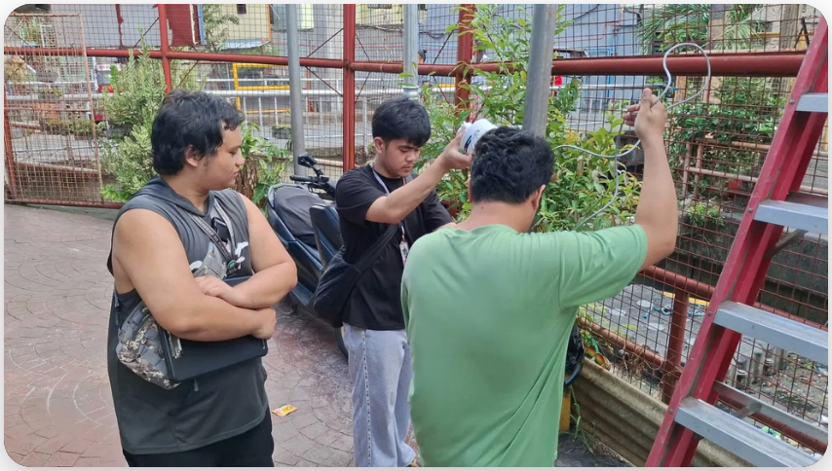


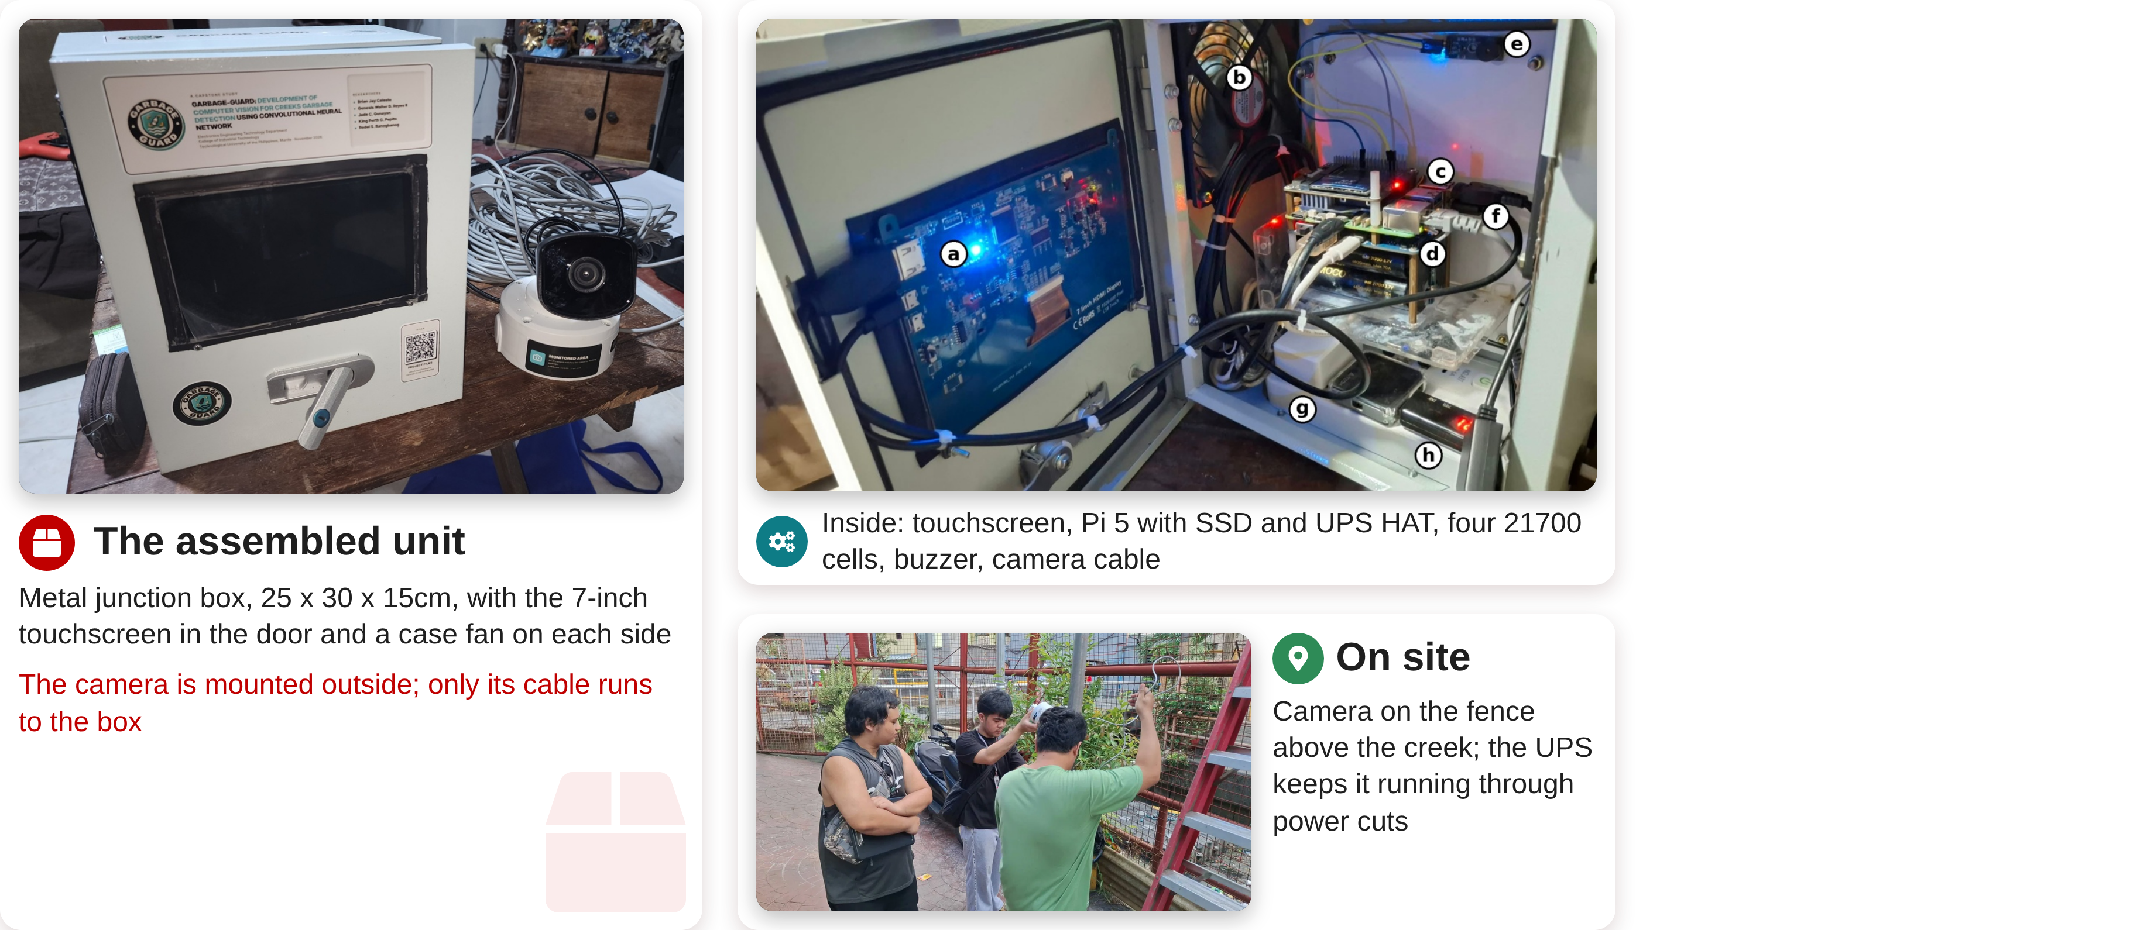
The Prototype
DESIGN/DEVELOPMENT
The assembled unit
Inside: touchscreen, Pi 5 with SSD and UPS HAT, four 21700 cells, buzzer, camera cable
Metal junction box, 25 x 30 x 15cm, with the 7-inch touchscreen in the door and a case fan on each side
On site
The camera is mounted outside; only its cable runs to the box
Camera on the fence above the creek; the UPS keeps it running through power cuts

Slide 9
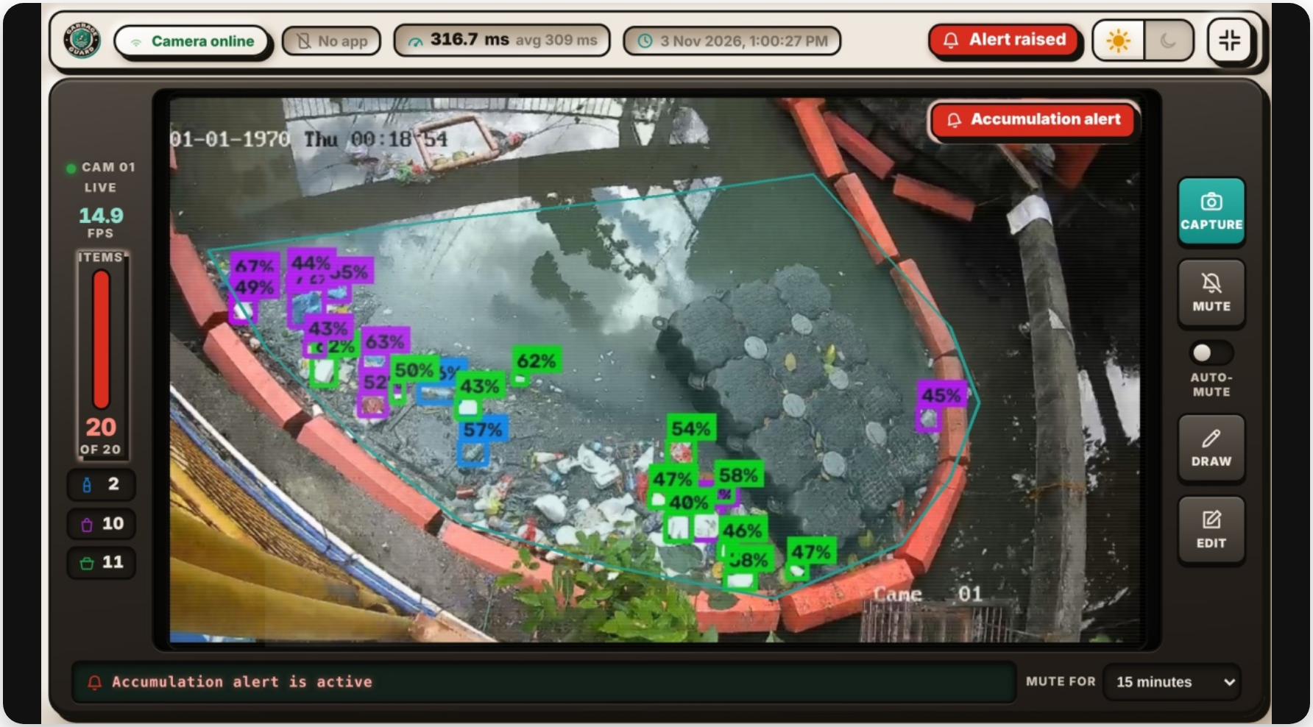
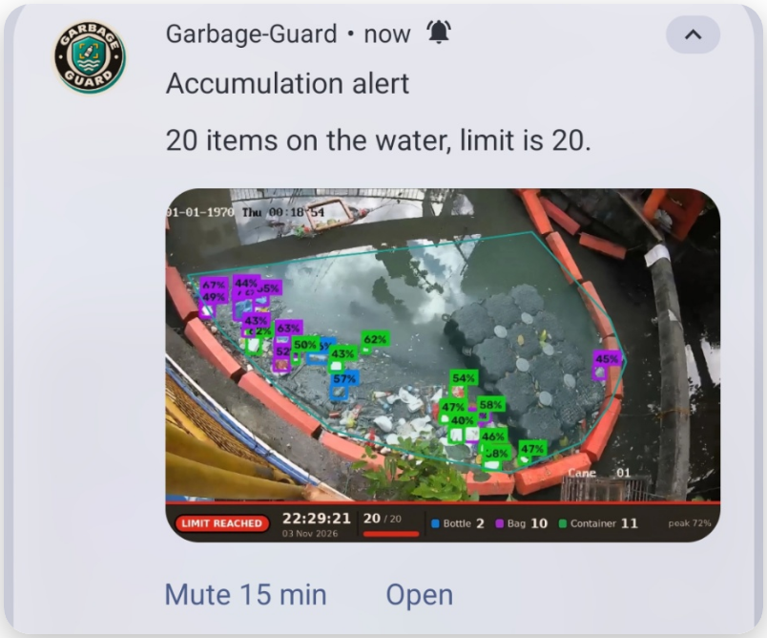












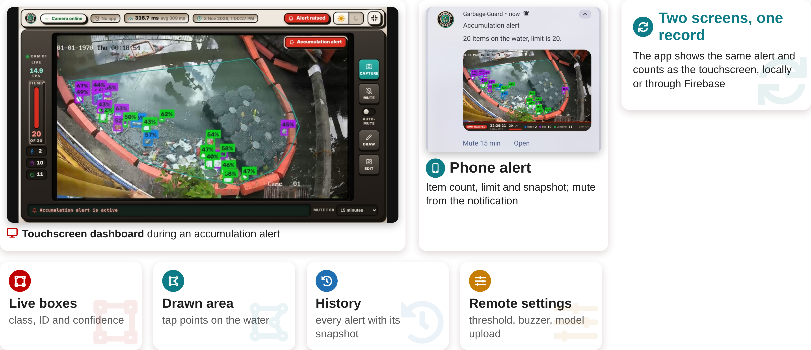
Dashboard and Mobile App
FEATURES
Two screens, one record
The app shows the same alert and counts as the touchscreen, locally or through Firebase
Phone alert
Item count, limit and snapshot; mute from the notification
Touchscreen dashboard during an accumulation alert
Live boxes
Drawn area
History
Remote settings
class, ID and confidence
tap points on the water
every alert with its snapshot
threshold, buzzer, model upload

Slide 10







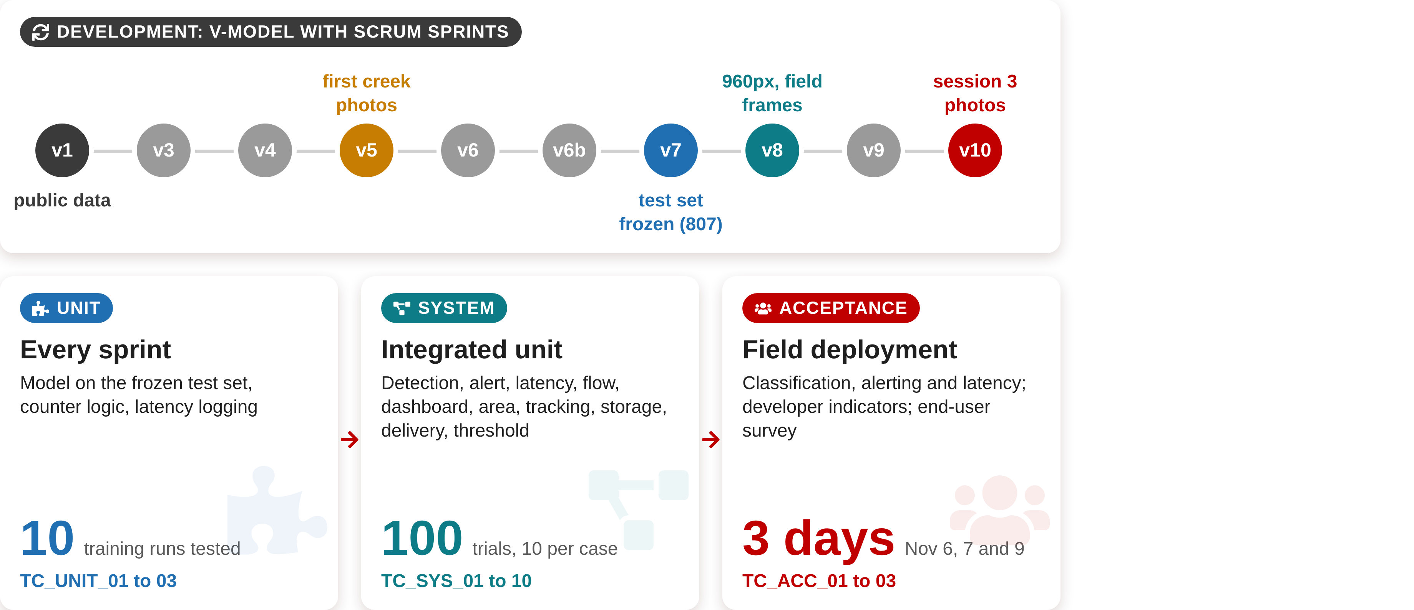
Development and Testing
TESTING PROCEDURE
DEVELOPMENT: V-MODEL WITH SCRUM SPRINTS
first creek photos
960px, field frames
session 3 photos
v1
v3
v4
v5
v6
v6b
v7
v8
v9
v10
public data
test set frozen (807)
UNIT
SYSTEM
ACCEPTANCE
Every sprint
Integrated unit
Field deployment
Model on the frozen test set, counter logic, latency logging
Detection, alert, latency, flow, dashboard, area, tracking, storage, delivery, threshold
Classification, alerting and latency; developer indicators; end-user survey
10
100
3 days
training runs tested
trials, 10 per case
Nov 6, 7 and 9
TC_UNIT_01 to 03
TC_SYS_01 to 10
TC_ACC_01 to 03

Slide 11








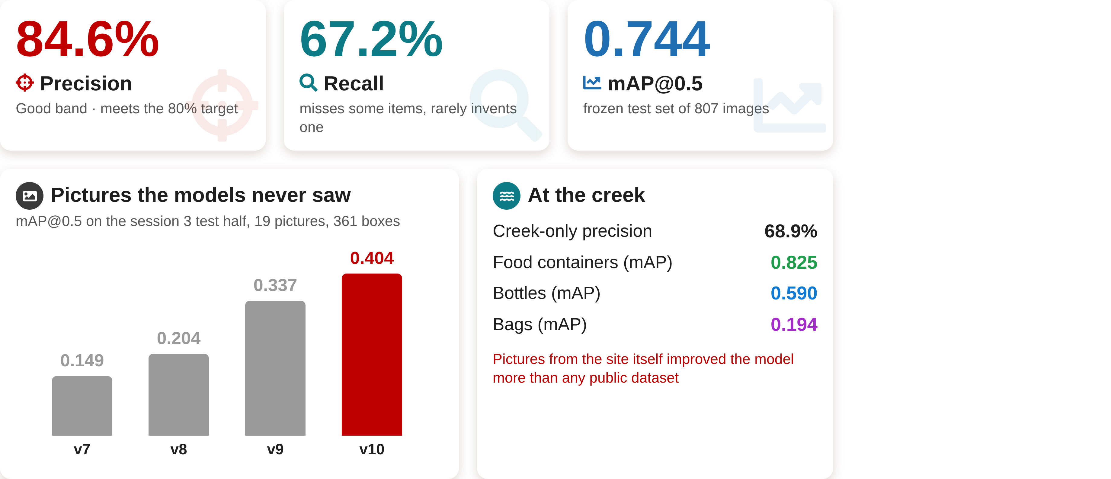
Detection Model Results
TEST RESULTS
84.6%
67.2%
0.744
Precision
Recall
mAP@0.5
Good band · meets the 80% target
misses some items, rarely invents one
frozen test set of 807 images
Pictures the models never saw
At the creek
mAP@0.5 on the session 3 test half, 19 pictures, 361 boxes
Creek-only precision
68.9%
0.404
Food containers (mAP)
0.825
0.337
Bottles (mAP)
0.590
Bags (mAP)
0.194
0.204
0.149
Pictures from the site itself improved the model more than any public dataset
v7
v8
v9
v10

Slide 12












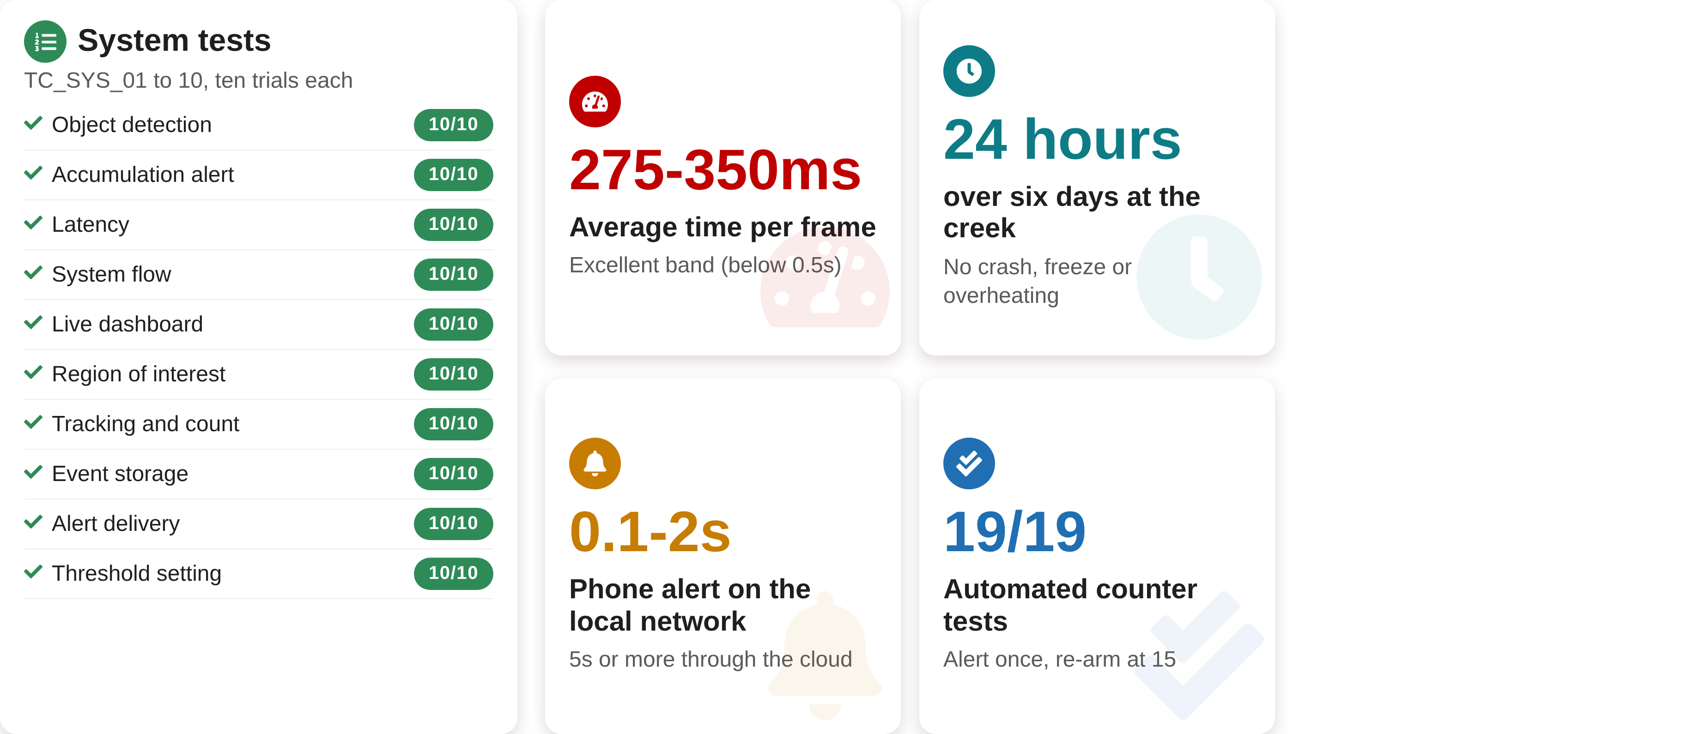
System and Field Results
TEST RESULTS
System tests
TC_SYS_01 to 10, ten trials each
Object detection
10/10
24 hours
Accumulation alert
275-350ms
10/10
over six days at the creek
Latency
10/10
Average time per frame
System flow
10/10
Excellent band (below 0.5s)
No crash, freeze or overheating
Live dashboard
10/10
Region of interest
10/10
Tracking and count
10/10
Event storage
10/10
Alert delivery
10/10
0.1-2s
19/19
Threshold setting
10/10
Phone alert on the local network
Automated counter tests
5s or more through the cloud
Alert once, re-arm at 15

Slide 13









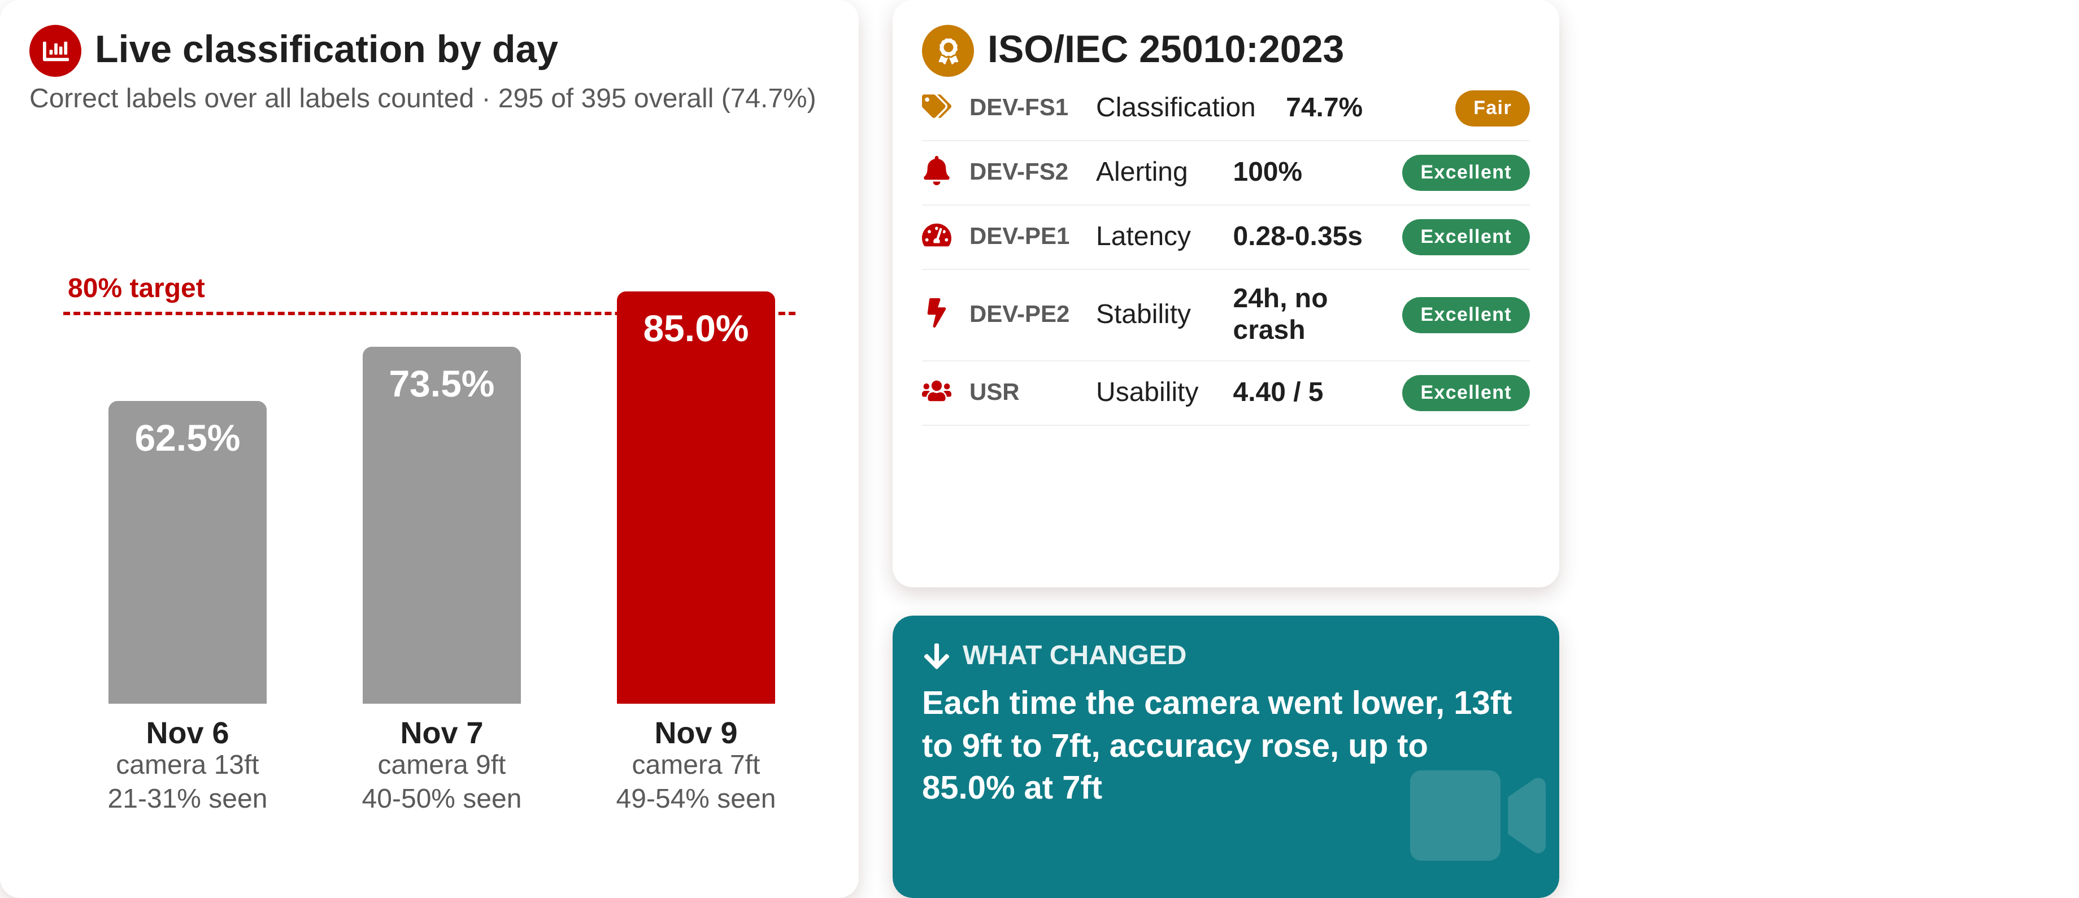
Field Accuracy and Evaluation
TEST RESULTS
Live classification by day
ISO/IEC 25010:2023
Correct labels over all labels counted · 295 of 395 overall (74.7%)
DEV-FS1
Classification
74.7%
Fair
DEV-FS2
Alerting
100%
Excellent
DEV-PE1
Latency
0.28-0.35s
Excellent
80% target
24h, no crash
85.0%
DEV-PE2
Stability
Excellent
73.5%
USR
Usability
4.40 / 5
Excellent
62.5%
WHAT CHANGED
Each time the camera went lower, 13ft to 9ft to 7ft, accuracy rose, up to 85.0% at 7ft
Nov 6
Nov 7
Nov 9
camera 13ft
21-31% seen
camera 9ft
40-50% seen
camera 7ft
49-54% seen

Slide 14














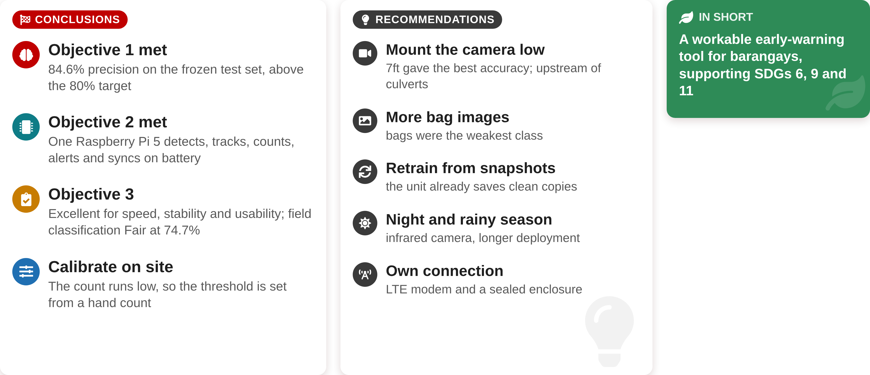
Conclusions and Recommendations
CONCLUSIONS AND RECOMMENDATIONS
CONCLUSIONS
RECOMMENDATIONS
IN SHORT
Objective 1 met
Mount the camera low
A workable early-warning tool for barangays, supporting SDGs 6, 9 and 11
84.6% precision on the frozen test set, above the 80% target
7ft gave the best accuracy; upstream of culverts
Objective 2 met
More bag images
One Raspberry Pi 5 detects, tracks, counts, alerts and syncs on battery
bags were the weakest class
Retrain from snapshots
Objective 3
the unit already saves clean copies
Excellent for speed, stability and usability; field classification Fair at 74.7%
Night and rainy season
infrared camera, longer deployment
Calibrate on site
Own connection
The count runs low, so the threshold is set from a hand count
LTE modem and a sealed enclosure

Slide 15

THANK YOU!!

